Slide 1
Dart and Flutter

Slide 2

Notes:
Made by google
Started out for web apps now it is also used to create mobile apps
Can also be used on the server-side and command – line
Powerful frameworks like angular-dart and flutter
General purpose tooling as well as framework-specific tooling

Slide 3
Why Dart?
Productive
Fast
Portable
Approachable
Reactive

Slide 4
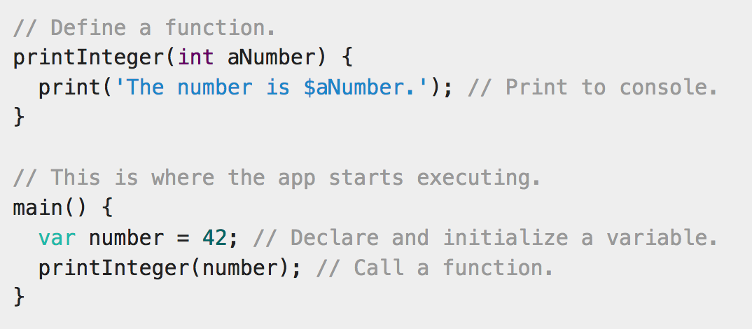
A simple program

Slide 5

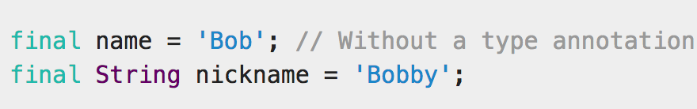
var and final

Slide 6
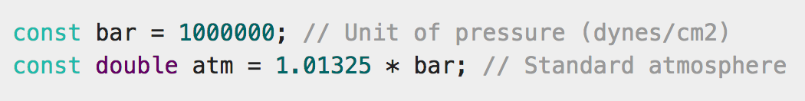
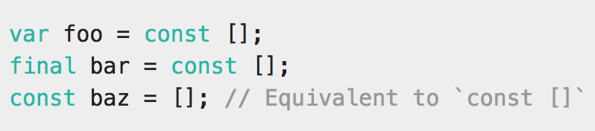
const

Slide 7
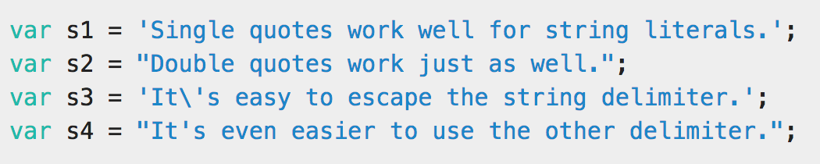
Strings

Slide 8
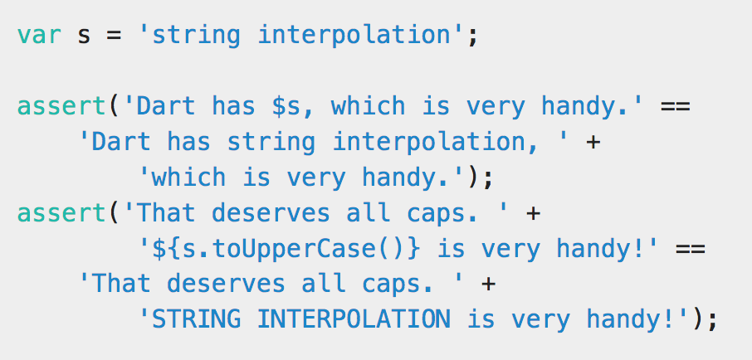
String interpolation

Slide 9
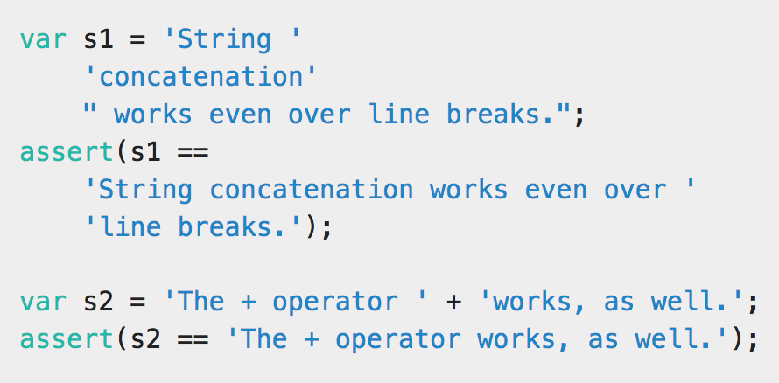
String concatenation

Slide 10
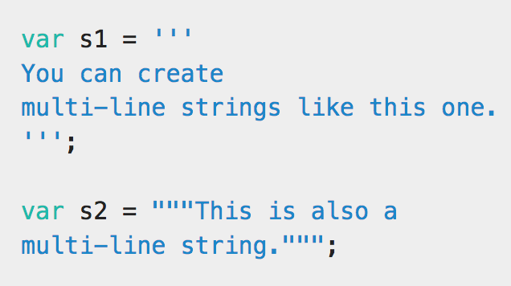
Multiline Strings

Slide 11
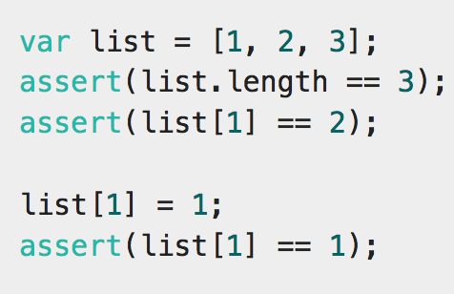
Lists

Slide 12
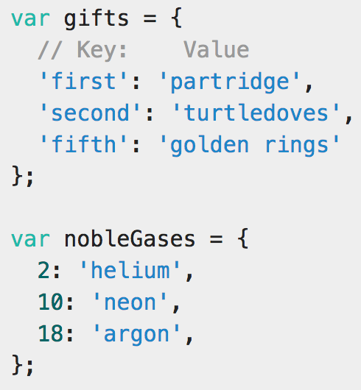
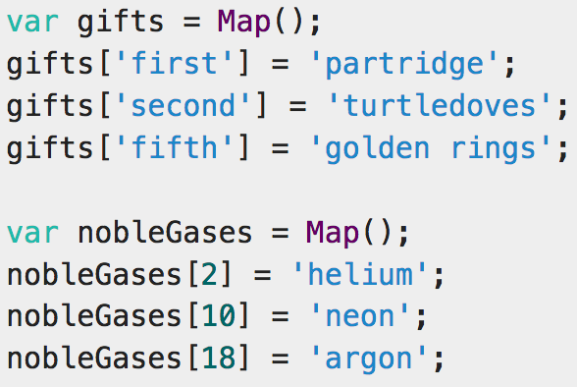
Maps

Slide 13
Fin

